Slide 1
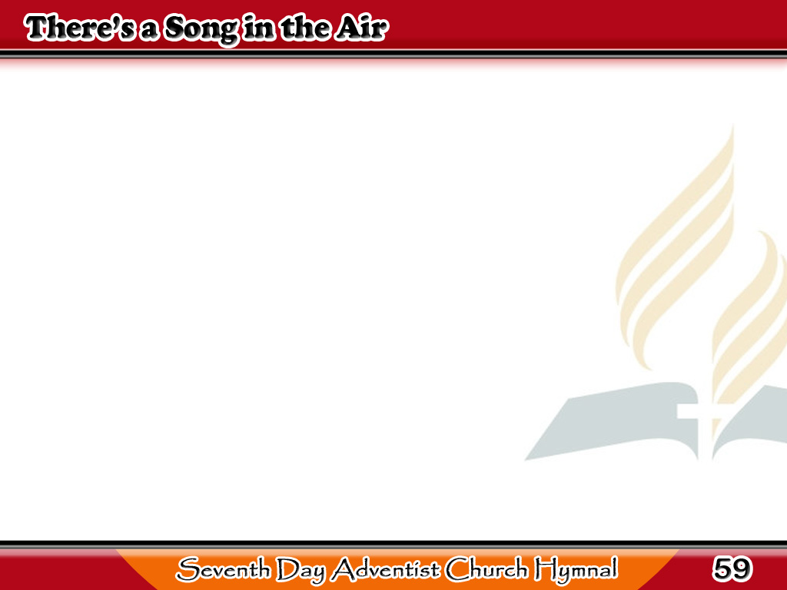
May Awit sa Hangin
There’s a song in the air!
There’s a star in the sky!
There’s a mother’s deep prayer
And a baby’s low cry!
1/4

Slide 2
May Awit sa Hangin
And the star rains its fire
while the beautiful sing,
For the manger of Bethlehem
cradles a King!
1/4

Slide 3
May Awit sa Hangin
There’s a tumult of joy
O’er the wonderful birth,
For the virgin’s sweet boy
Is the Lord of the earth.
2/4

Slide 4
May Awit sa Hangin
Aye! the star rains its fire
while the beautiful sing,
For the manger of Bethlehem
cradles a King!
2/4

Slide 5
May Awit sa Hangin
In the light of the star
Lie the ages impearled;
And that song from afar
Has swept over the world.
3/4

Slide 6
May Awit sa Hangin
Every hearth is aflame,
and the beautiful sing
In the homes of the nations
that Jesus is King!
3/4

Slide 7
May Awit sa Hangin
We rejoice in the light,
And we echo the song
That comes down
through the night
From the heavenly throng.
4/4

Slide 8
May Awit sa Hangin
Aye! We shout to the lovely
evangel they bring,
And we greet in His
cradle our Savior and King!
4/4

